Slide 1
Modeling the Impacts of
Voluntary Agreements &
Information Programs on
US Industry's Energy Intensity
Presented to
National Energy Modeling System Conference
March 12, 2002
Gale A. Boyd
Argonne National Laboratory

Slide 2
Modeling Voluntary Agreements & Information Programs (VAIP) Face a Series of Challenges
There are a wide variety of VAIP
  R&D ³
    R&D technology introduction
    D&D technology adoption
  Regulatory Relief
Translation to Modeling
  Quantify new technological possibilities
  Quantify penetration
  Distinguish from other ‘economic and technical’ drivers
  Goals of specific VAIP
    Lower ‘barriers’ and ‘no regrets’
    Social optimum
Assessing performance of VAIP
  Payoff for R&D is high
  DSM assessments and case studies

Slide 3
Top-down and Bottom-up Modeling Approaches Both Have Similar Challenges
Characterizing the status quo
  Static: Actual performance / state of practice
  Dynamic: “autonomous” change
Characterize technical possibilities
  Static: Difference between actual and potential performance
  Dynamic: Changing over time
Operationalize the observed behavior
  Optimization or Statisficing
  Stock adjustment?

Slide 4
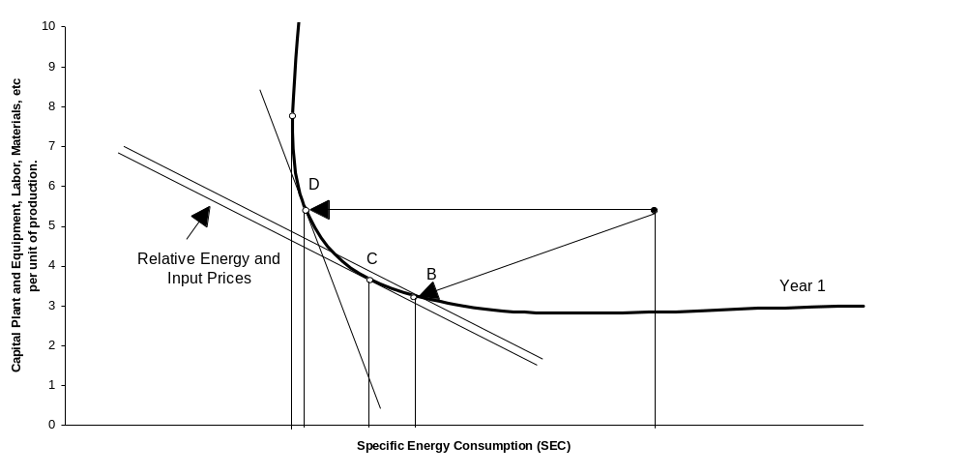
In Economic Terms, these Challenges can be Represented Via Frontier Production Functions

Slide 5
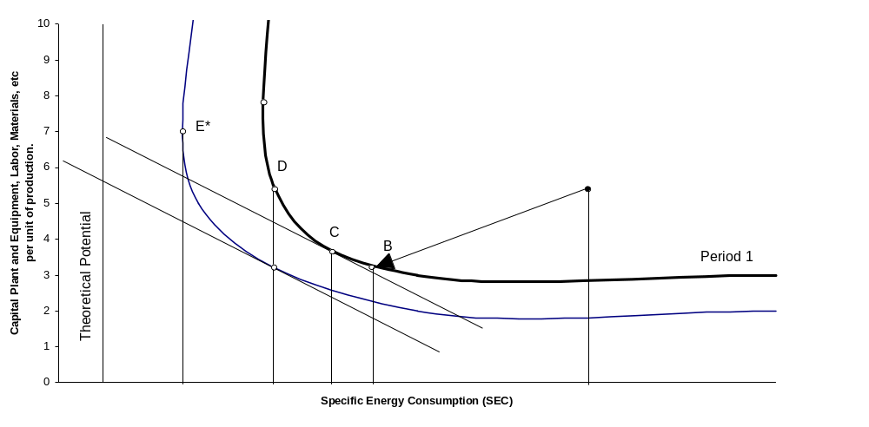
New technology shifts the picture

Slide 6
Different Models Provide Placeholders to Represent the Impact of VAIP
The status quo in LIEF is characterized by the ‘Gap’
  The Gap is the ratio of actual to ‘ideal’ energy intensity
  Ideal energy intensity is function of
    Capital Recovery Factor and
    Energy price
Dynamic elements in LIEF include
  Penetration (stock turnover, etc.) which represents ‘closing the gap’
  Autonomous shifts
Compared to NEMS
  TPC and UEC combines notions of the Gap and autonomous shift but without price effects
  Stock turnover provides a similar modeling role to penetration
LIEF and NEMS produce similar results in the 5-Lab study
  LIEF double penetration and cut CRF from 33% to 15%
  NEMS double stock turnover and TPC

Slide 7
The Real Challenge to Modeling is in Assessing the Performance of VAIP
Information on participants, but not non-participants
  Sample selection bias
  Case studies cannot be relied upon to generalize to a population
  Separating the role of other economic drivers from program effects
VAIP do something, but how much?
  Morgenstern & Al Jurf (1999) - Information accelerates adoption
  DeCanio & Watkins (1998) - Participation related to firm characteristics
  Other environmental literature (TRI 33/50)
  Analysis of IAC show that rebates also serve signaling function
Market transformation

Slide 8
Combining Participant and Non-participant Data at the Census Provides a Research Opportunity
Past research has measured the range of plant level energy and productivity performance in many industries
Separating a variety of effects, e.g. vintage, energy prices, and learning by doing, on productivity and energy efficiency is feasible.
New research for EPA EnergyStar identifies the range of performance within an industry for benchmarking purposes, i.e. identifying the status quo and potential.
Identifying program participants vs. non-participants within an industry group can measure:
  Between group differences, controlling for external factors
  Within group performance over time
  Representations of the “GAP”, autonomous change, CSC, TPC, etc.
  The impact of VAIP participation on these estimates.

